Slide 1

UrbanTel Support Workflow Optimization
Prepared by: Arsen Tagibekov
Date: April, 2025
Notes:
Hello, my name is Arsen Tagibekov, and this is a business process optimization case study I conducted for a fictional telecom company called UrbanTel. This project simulates a real-world scenario in which I was brought in as a Business Analyst to improve the company’s customer support workflow.

Slide 2
Contents
01.
Project Background
02.
Business Problem
03.
Project Objectives
04.
Stakeholder Inputs
05.
AS-IS Workflow
06.
Pain Point Summary
07.
TO-BE Workflow
08.
Proposed Solution Features
09.
KPIs & Success Metrics
10.
Business Impact
11.
Conclusion & Next Steps
Notes:
Here is the list of points that this presentation covers; from Project Background to Business Impact and Conclusion that also provides information on the next steps to enhance the way UrbanTel’s customer support operates.

Slide 3
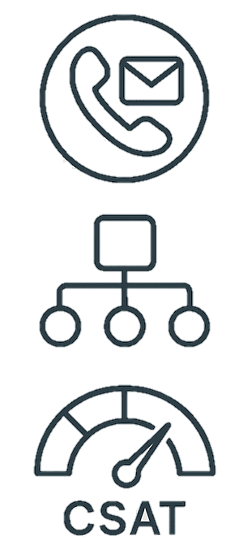
Project Background
UrbanTel s a mid-sized telecom provider (500k + customers)
Facing increasing support requests
Current process = phone, email, manual tickets
CSAT (Customer Satisfaction) scores falling, resolution times increasing
Notes:
UrbanTel is a mid-sized telecom provider with over half a million customers. As the company grew, so did the volume and complexity of its customer support requests. Their current support system relied on manual processes—mainly phone calls and emails—which led to longer resolution times and a noticeable decline in customer satisfaction scores.

Slide 4
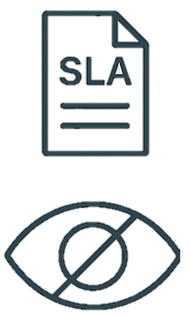

Business Problem
Manual escalations that cause frequent misrouting
No visibility leading to repeated customer complaints
Poor SLA handling, no real-time updates
Technical handoffs = delayed, unclear
Key stakeholders frustrate
Notes:
The company faced critical inefficiencies: tickets were often escalated to the wrong team, agents had limited visibility into past cases, and customers had to repeat their issues multiple times. There was no tracking of service-level agreements, and escalations were inconsistent and manual. These pain points created internal stress and a frustrating customer experience.

Slide 5
Project Objectives
Map AS-IS Process
Recommend automation
Identify inefficiencies
Define KPIs
Design optimized TO-BE Process
Deliver BRD & stakeholder-ready outputs
Notes:
My role was to analyze the current process, identify root issues, design a more efficient future-state workflow, and produce key deliverables including stakeholder analysis, process diagrams, a business requirements document, and KPI definitions to measure success.

Slide 6
Stakeholder Inputs
Support Agent
Support Team Lead
No intelligent ticket routing
Agents manually escalate without context
Ticket duplication exists
Poor visibility into customer ticket history
No SLA tracking or auto-prioritizing
Manual supervision and sorting
Escalation rules are not standardized
Reporting is manual, not real-time
Status tracking is inconsistent
IT Operations Lead
Customer
No smart routing, no automation
CRM and support systems are not integrated
No live dashboard for ticket tracking or SLAs
Opportunity for chatbot and keyword-based triage
Support-to-technical team handoff is unclear and inefficient
No ticket ownership perception
Lack of proactive status updates
Repetition: customer must re-explain issue
Long delays and unclear handoffs
Communication is reactive, not structured
Notes:
I conducted simulated stakeholder interviews with agents, leads, IT, and a customer persona. Each revealed unique insights—for example, agents noted ticket duplication and poor routing logic, while IT pointed out that tickets lacked sufficient context. The customer highlighted the lack of updates and unclear ownership of their cases.

Slide 7
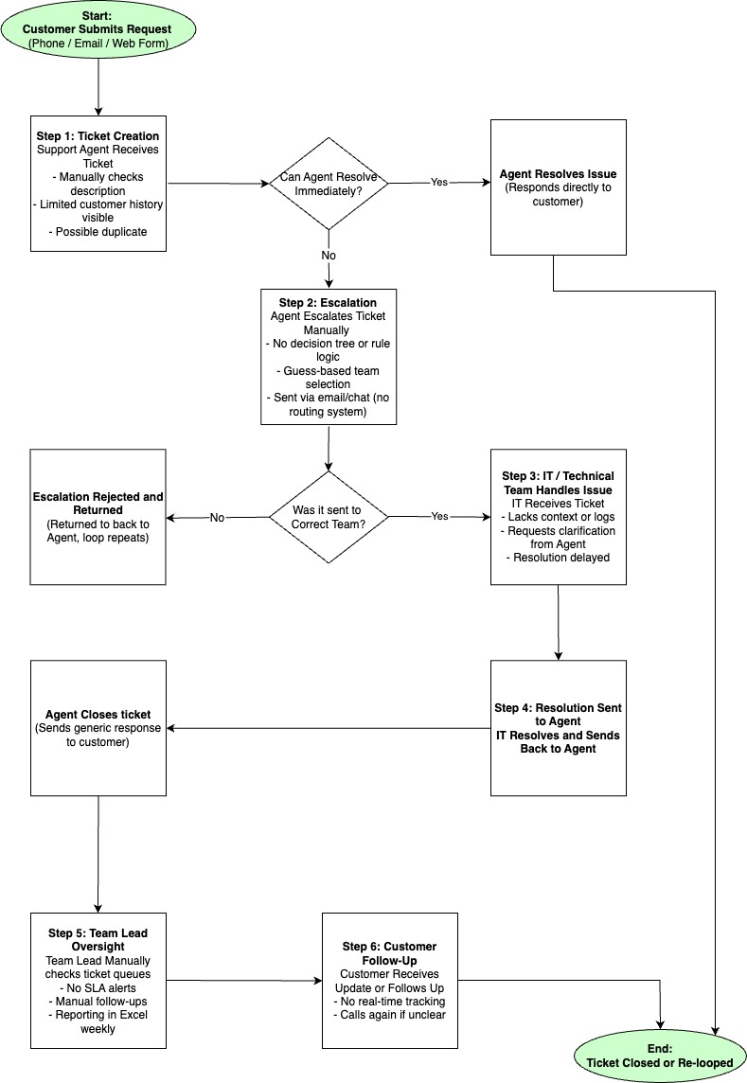
AS-IS Workflow
Entire ticket lifecycle
Key issues: lopping behavior, no SLA timers, and
inconsistent resolution tracking
Major bottlenecks: “Escalation Rejected and Returned” box and “Step 6: Customer Follows Up”
Notes:
This diagram outlines the existing workflow. You’ll see the entire ticket lifecycle, from the moment a customer submits a request, to manual agent handling, escalation delays, and lack of real-time updates. Key issues include looping behavior, no SLA timers, and inconsistent resolution tracking.
(Tip: Point to boxes like "Escalation Rejected" or "Customer Follows Up" as major bottlenecks)

Slide 8

Pain Point Summary
Lack of automation and intelligent routing
No standardized workflows or escalation criteria
Disconnected systems (CRM, ticketing, reporting)
Manual workarounds increase delays and workload
Poor communication and visibility for both staff and customers
Notes:
Summarizing the feedback, we categorized the core issues into five themes: lack of automation, disorganized escalation flow, disconnected systems, poor visibility, and inconsistent communication. These were cross-cutting concerns shared by both frontline staff and leadership.

Slide 9
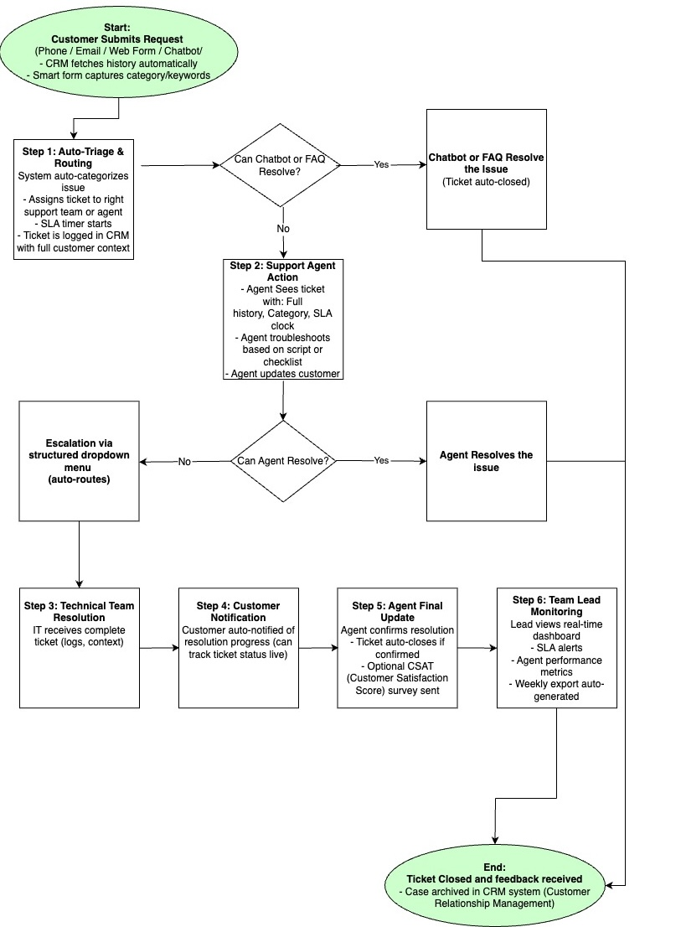
TO-BE Workflow
Automation and Structure are implemented
Keyword triage to auto-assign tickets
Chatbot handles simple queries
SLA timers are introduced
All activity is tracked in real time
Notes:
In the redesigned process, we implement automation and structure. The system uses keyword triage to auto-assign tickets, a chatbot handles simple queries, SLA timers are introduced, and all activity is tracked in real time. The process includes checkpoints for proactive communication and better IT collaboration.

Slide 10

Proposed Solution Features
Auto-routing by keyword
CRM integration
Chatbot for FAQs
SLA countdowns & alerts
Real-time dashboard & CSAT survey
Notes:
Some of the improvements include: structured escalation menus, customer status trackers, CRM integration for history visibility, and real-time dashboards for support leads. The workflow is built around ownership, speed, and data visibility.

Slide 11
KPIs & Success Metrics
KPI | Definition | Goal | Tracking Method
Average Resolution Time | Total time from ticket creation to closure | 40% decrease | SLA timers in system + dashboard
First Contact Resolution (FCR) | % of tickets resolved in first agent interaction | More or equal to 60% | Auto-flag if no escalation
SLA Breach Rate | % of tickets not resolveed within SLA | Less or equal to 5% | Tracked via system alerts
Customer Satisfaction (CSAT) | Average score from post-resolution surveys | More or equal to 85% | Triggered survey after closure
Agent Touch Time | Average minutes agent spends per ticket | 30% decrease | Tracked in ticket log
Re-routing Rate | % of escalations that bounce to wrong team | 50% decrease | Escalation path audit
Notes:
We defined six KPIs to track performance. For example, we expect a 40% reduction in average resolution time, a 50% drop in misrouted escalations, and a CSAT score of at least 85%. These metrics are designed to show measurable value across the support ecosystem.

Slide 12

Business Impact
Time savings: 12 FTE hours/day
Cost savings: 6-8 hours/week/lead
CSAT increased, leading to customer retention, fewer callbacks
Fewer delays that decrease churn
Real-time reporting → faster management action
Notes:
Beyond improving workflow, the business value is significant. Automation saves time for agents and team leads, while real-time dashboards reduce missed SLAs. Better communication means fewer callbacks and higher retention. Overall, this redesign not only improves efficiency but also enhances the customer experience.

Slide 13
Conclusion & Next Steps
Scalable, transparent support workflow
Better agent tools and team communication
Data-driven performance oversight
Next steps: stakeholder alignment & system planning
Notes:
To conclude, this project demonstrates how structured process thinking, stakeholder input, and smart automation can transform customer support. The next logical steps would include aligning with the technical team on implementation and launching a pilot version of the TO-BE workflow.”

Slide 14
Thank you
for your attention !
Notes:
Thank you for reviewing this case. I’d be happy to discuss the process, logic, or tools I used in more detail.

